Slide 1
DATA SCIENCE FUNDAMETAL
FAKE NEWS DETECTION
PRESENTED BY:R.BASKAR
B Tech Agricultural Engineering
Sri Jayaram Institute Of Engineering And Technology

Slide 2
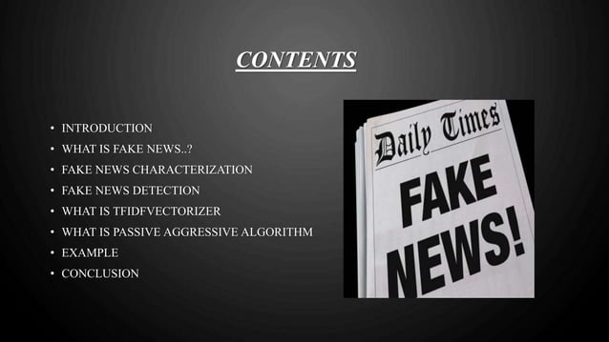

Slide 3
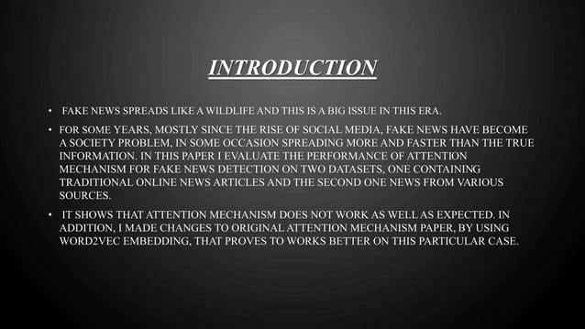

Slide 4
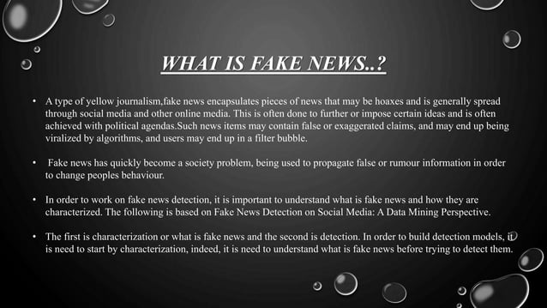

Slide 5
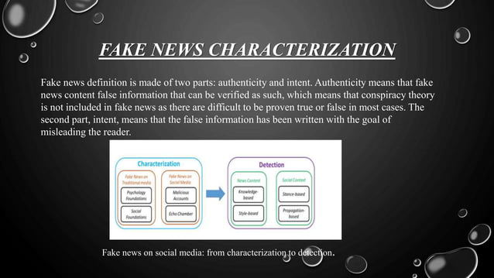

Slide 6
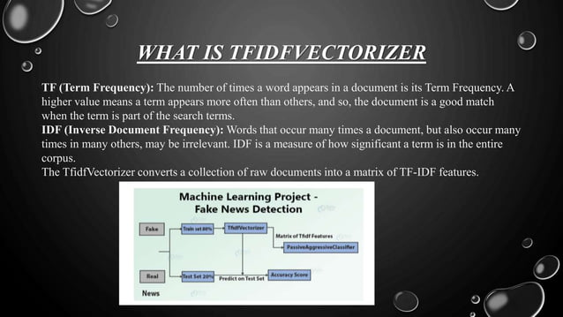

Slide 7
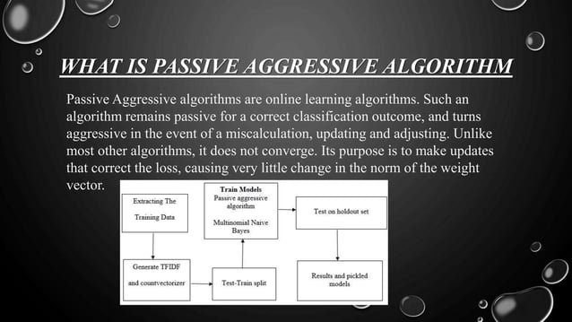

Slide 8
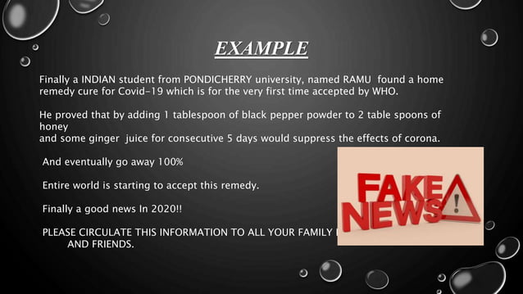

Slide 9
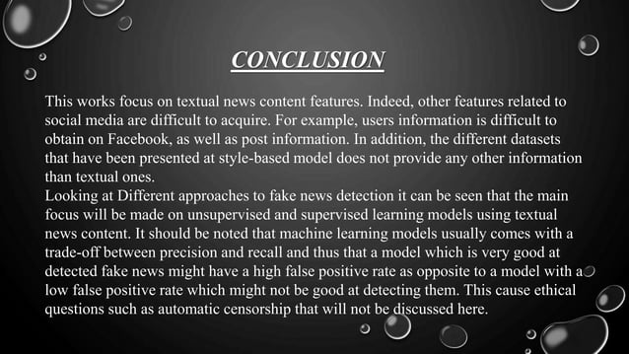

Slide 10


